Slide 1
Data Interactive: Data Interactive: Compare Must-Have Technology Skills as Reported by Financial Services Leaders Published 14 June 2023 ID G00794762 By Financial Services Business Leader Research Team

Slide 2
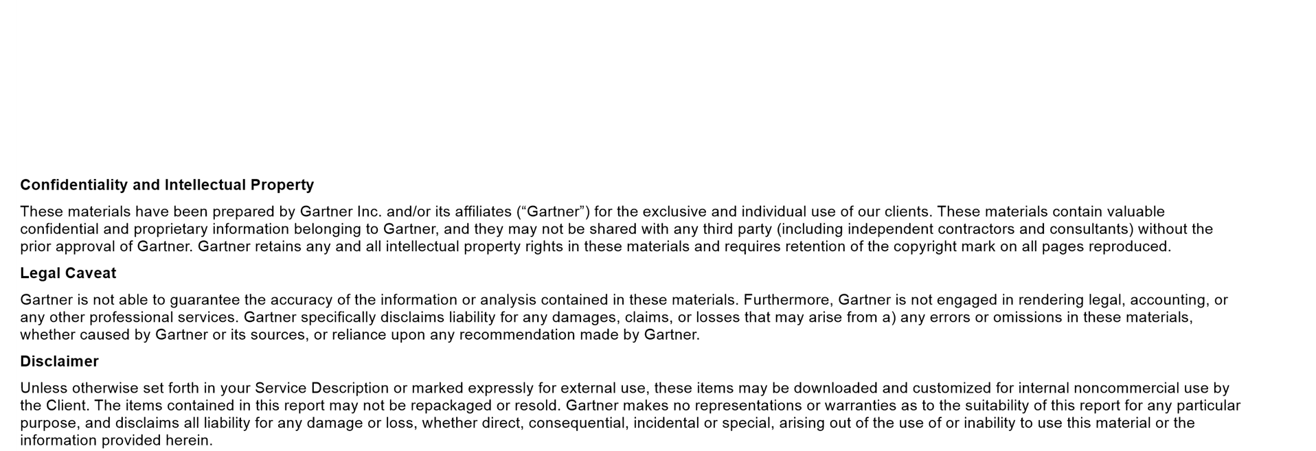

Slide 3
Summary
Financial services leaders can use this data tool to benchmark the most important technology workforce skills required right now, and compare them with peers based on geography, industry segment, or leader’s role.
Initiatives: Financial Services Business Leadership and Strategy

Slide 4
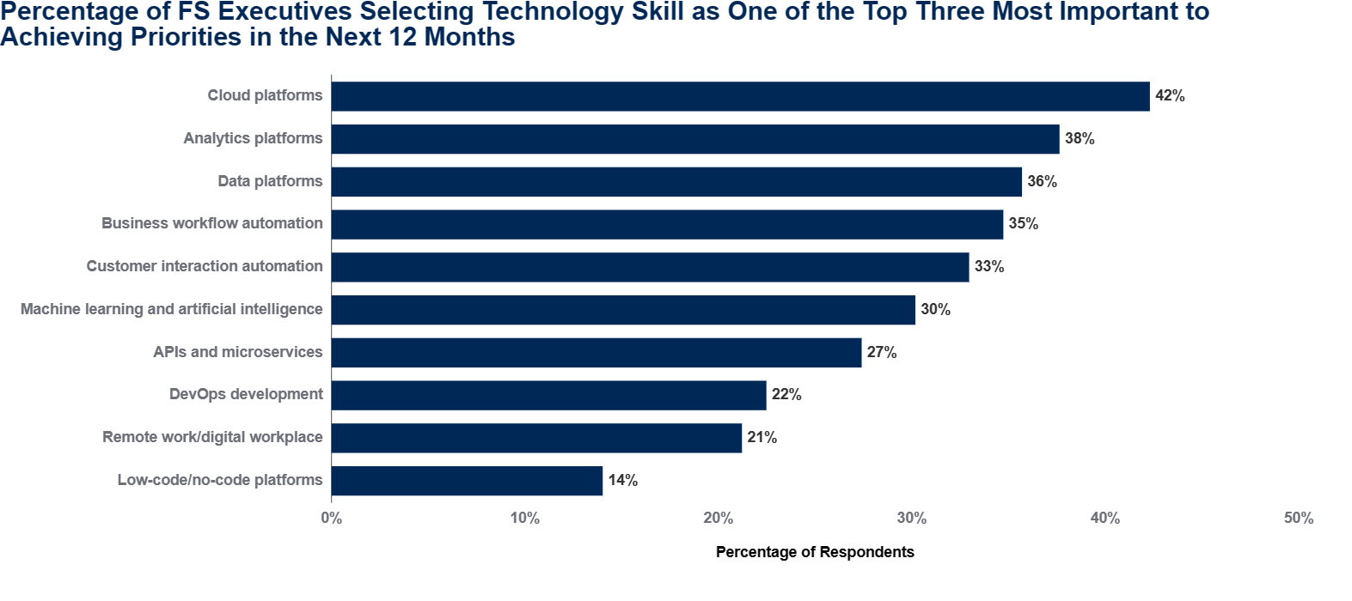
FILTERS: NONE
n = 794 Q: Rank the top three technology skills that will be most important to achieving your critical priorities over the next 12 months. Source: 2022 Gartner Financial Services Technology Survey

Slide 5
Data Insights
In financial services, achieving top enterprise priorities is increasingly dependent on employees’ technology skills. This data tool tracks 10 critical IT skills and benchmarks the percentage of industry leaders who select the skill as one of the three most critical to achieving the leader’s priorities in the next 12 months.
Our tool shows that, most frequently, cloud (42%), analytics platforms (38%), and data platforms (36%) are deemed most important, while low code/no code is at the bottom. But there are significant differences in employee skills need by industry and region:
Among insurance leaders, 40% say customer interaction automation is a top-three skill, surpassing data platforms as a top-three capability.
Cloud platform skills are rated of top importance to banking leaders. Moreover, almost half of banking executives in the APAC region rate machine learning and AI (47%) as the top skill, spiking well above the industry average of 32%.

Slide 6
About This Research
2022 Gartner Financial Services Technology Survey. This survey sought insights into the life cycle, utility and spending behavior associated with specific technologies for financial services enterprises. This survey was conducted online from October through December 2022. The respondents included senior leaders who were primary decision makers for their organizations’ or business units’ technology strategies or had a high level of influence in those decisions. The total sample was 794, with representation from all geographies and both banking and investment services and insurance industry sectors, among enterprises with over $50 million or equivalent in annual revenue.
Disclaimer: The results of this survey do not represent global findings or the market as a whole, but reflect the sentiments of the respondents and companies surveyed.

Slide 7
Recommended by the Authors
Infographic: Future Role of the Branch Banker in Financial Services
Case Study: Building Scale in Financial Services Automation (Assicurazioni Generali)
Overcome Talent and Skills Scarcity in Financial Services Operations Through Work Design
Infographic: Financial Services Business Priority Tracker 4Q22

